Slide 1
Data Visualization & Interpretation
Febin.A.Vahab

Slide 2
RECAP

Slide 3
Data Viz-Definition
Visualisation as a discovery tool(Anscombe’s Quartet)
Visualisation Objectives

Slide 4
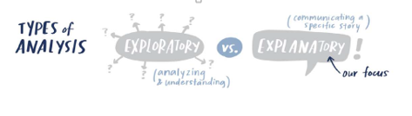
Car Manufacturer
DressMart Inc.
Article from NewYork Times
EDA on IRIS Data

Slide 5
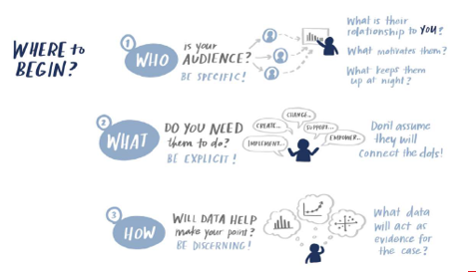
Visualisation Context
CASE Study
Summer Learning Programme
Clothing Retailer
DSE Electives
CANVAS
Higher Education
People Analyst

Slide 6
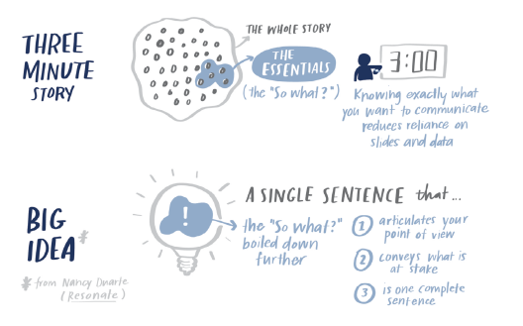

Slide 7
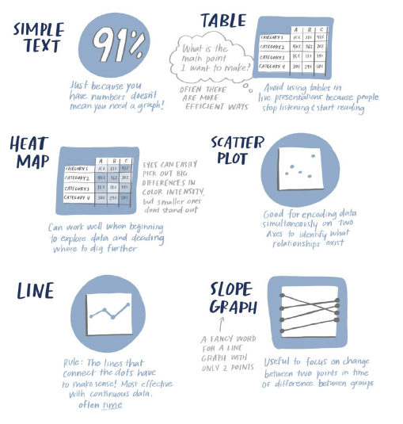
Types of Visuals

Slide 8
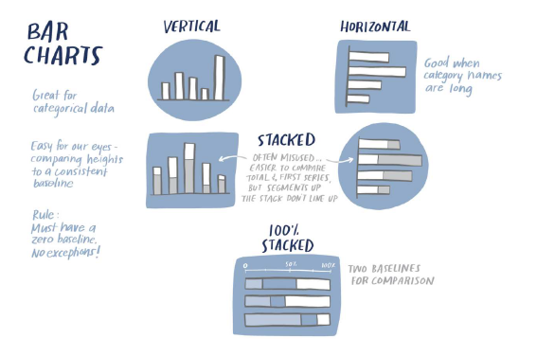
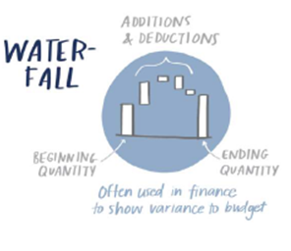
Types of Visuals
CASE Study
Summer Learning Programme
New Client Tier Share
Corporate Giving Programme(Canvas)
Capacity and Demand (Canvas)
Attrition rate(Canvas)
Graphs to be avoided

Slide 9

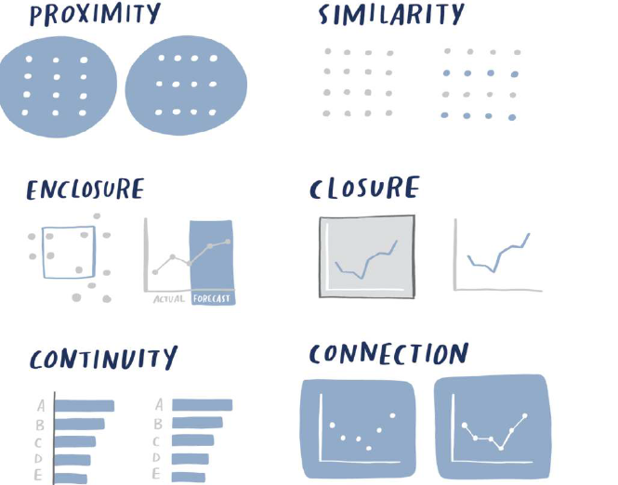
Visual Perception

Slide 10
SESSION 5 -PLAN
Decluttering
Pre-attentive Attributes

Slide 11
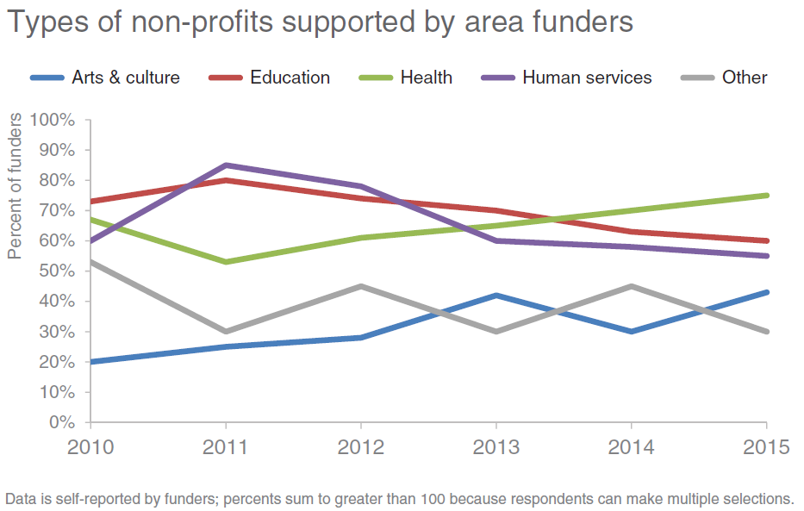
Case Study -Clutter
Types of non-profits supported by the corporate workforce
To Do: You are a Data Science Consultant. Convey to your CSR leadership team where they should plan to focus the organization’s CSR activity in the future

Slide 12
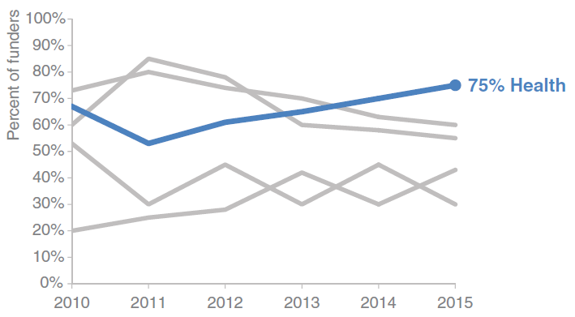
Case Study – probable solutions
Health sector shows the highest potential to receive grants in the future

Slide 13
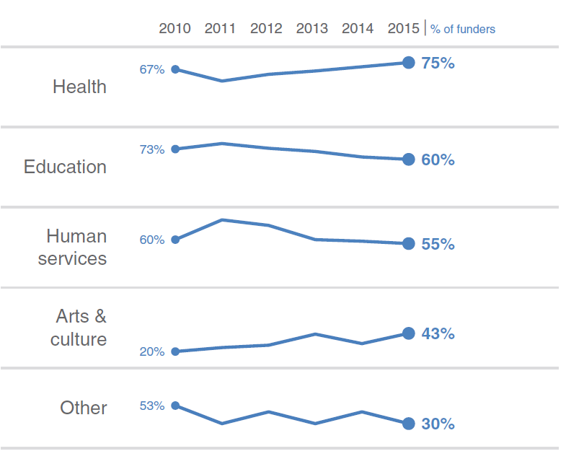
Case Study – probable solutions
Health sector shows the highest potential to receive grants in the future

Slide 14
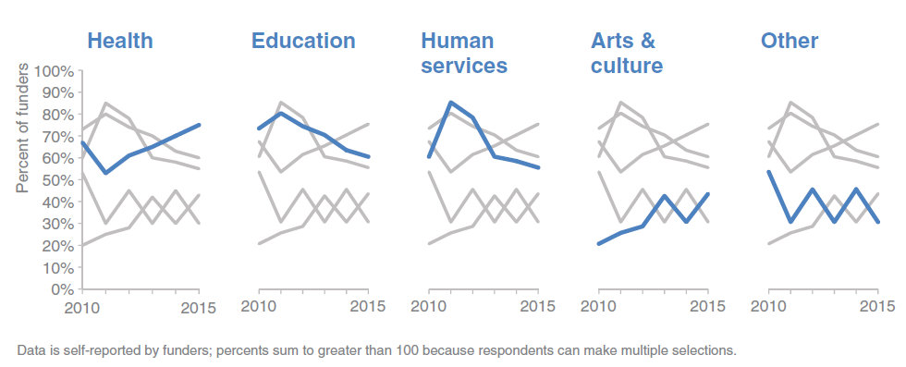
Case Study – probable solutions

Slide 15
Case study 1- USDA

Slide 16
Case study 2-Ticket Trend

Slide 17
Case study 3-Direct and Indirect sales.

Slide 18
Human Memory
How human sees?
How you can use that to your advantage when creating visuals?

Slide 19

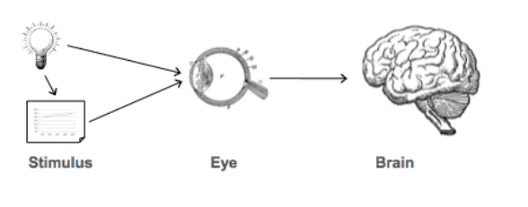
How Human sees?

Slide 20


See with Brain
Types of Human Memory
Iconic
Short term
Long term

Slide 21
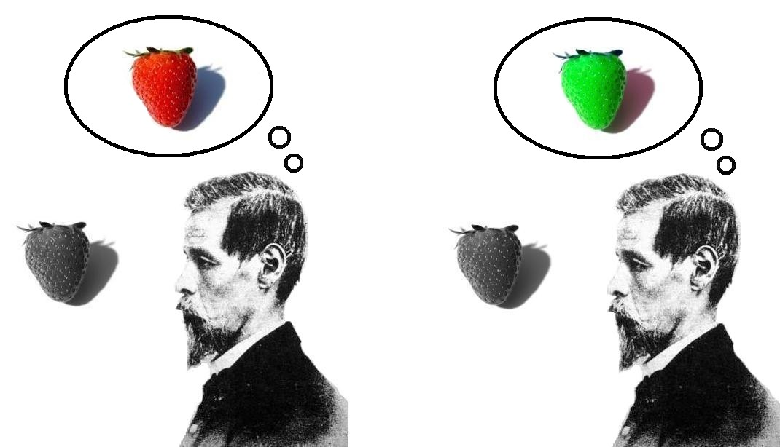
Types of Human Memory
Iconic Memory (example)

Slide 22
How to use human sight ?
Preattentive Attributes
Size
Color
Position
Help to direct audience’s attention to where you want them to focus in the visuals

Slide 23
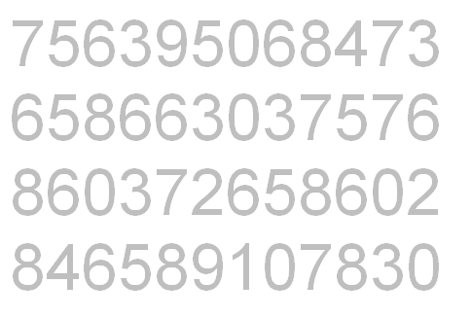
Preattentive Signals
Example

Slide 24
Preattentive Signals
Example
756395068473658663037576860372658602846589107830

Slide 25

Preattentive Signals
“Enable our audience to see what we want them to see before they even know they’re seeing it!”
- Cole Knaflic

Slide 26
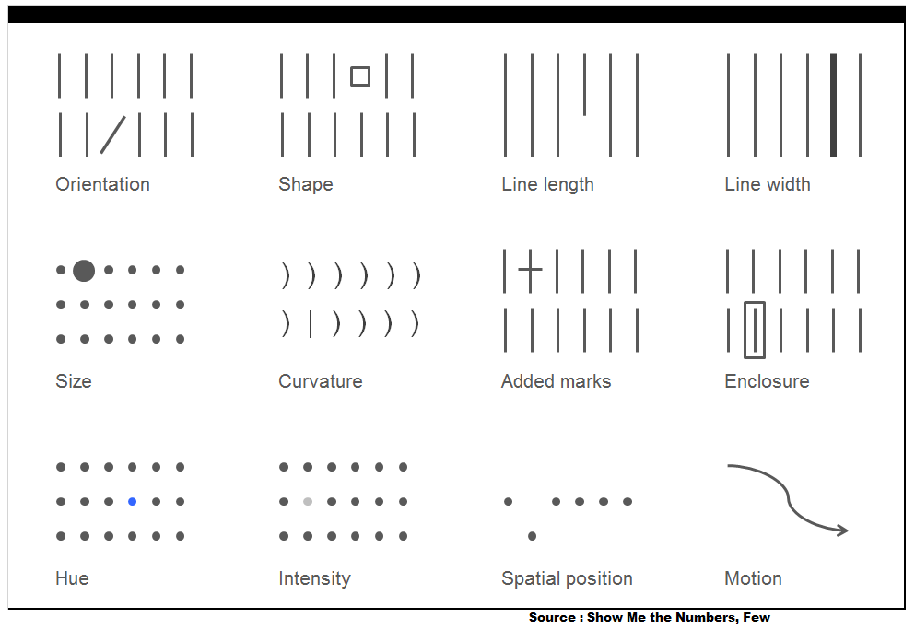
Preattentive Attributes

Slide 27
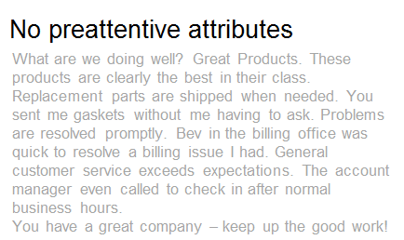
Preattentive Attributes In text
Example

Slide 28

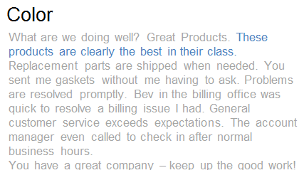
Preattentive Attributes In text
Example (use of color)

Slide 29

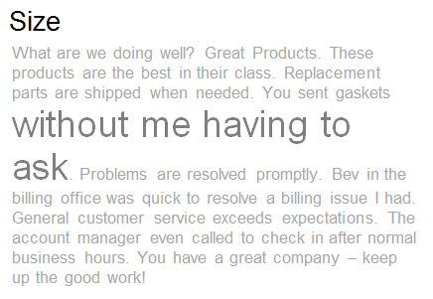
Preattentive Attributes In text
Example (use of Size)

Slide 30


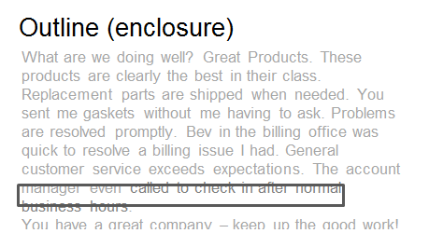
Preattentive Attributes In text
Example (use of enclosure)

Slide 31
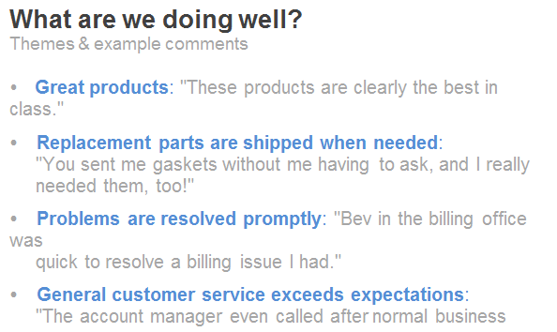
Preattentive Attributes In text
Example (information hierarchy)

Slide 32
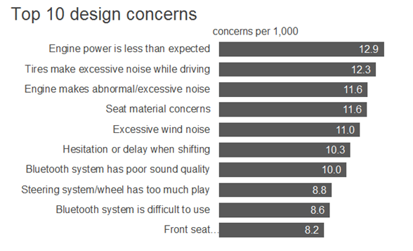
Preattentive Attributes In graphs
Example

Slide 33
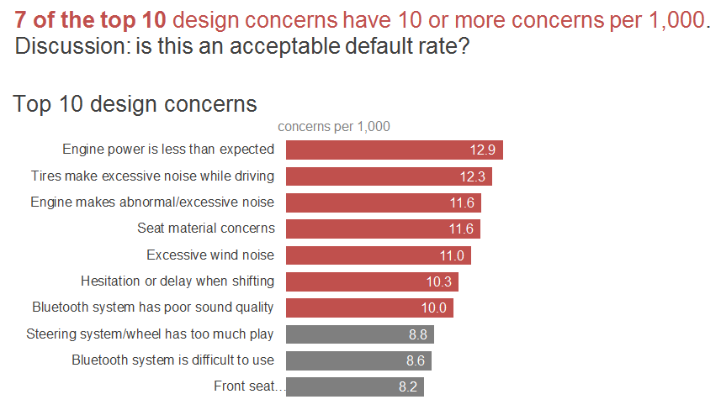
Preattentive Attributes In graphs
Example (use of color and text attributes)

Slide 34
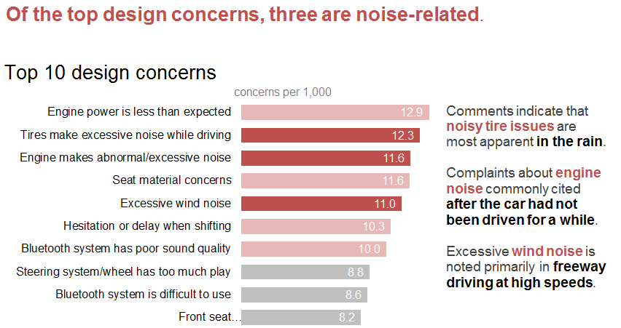
Preattentive Attributes In graphs
Example (Modified focus and text)

Slide 35
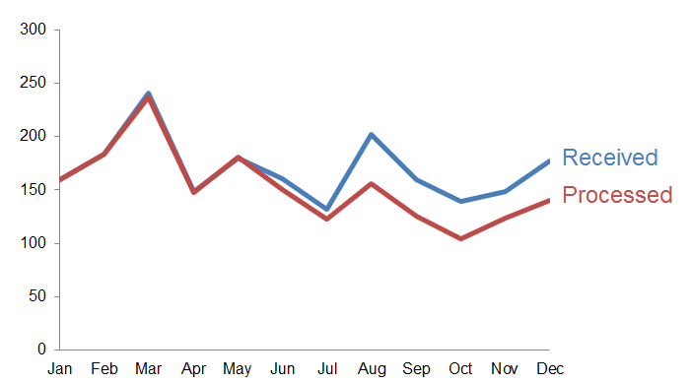
Preattentive Attributes In graphs
Another example

Slide 36
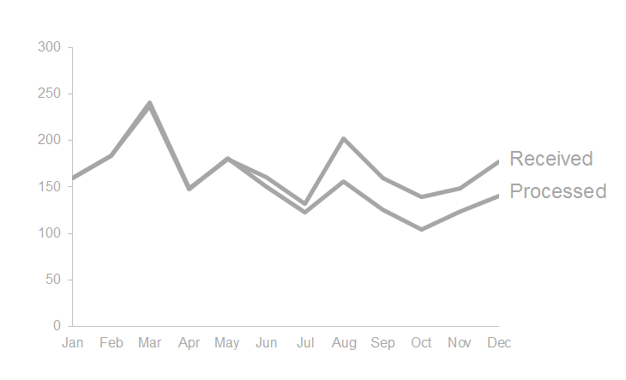
Preattentive Attributes In graphs
Another example (everything in background)

Slide 37
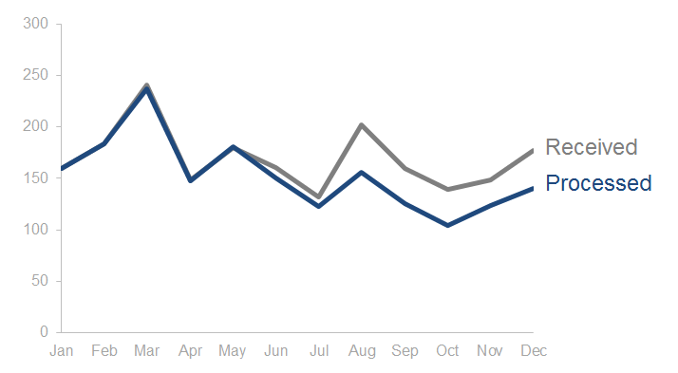
Preattentive Attributes In graphs
Another example (use color)

Slide 38
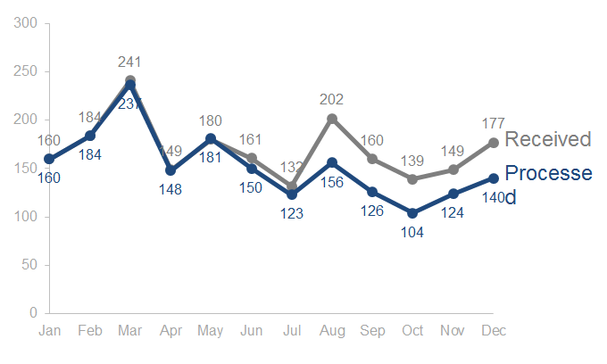
Preattentive Attributes In graphs
Another example (data labels and clutter)

Slide 39
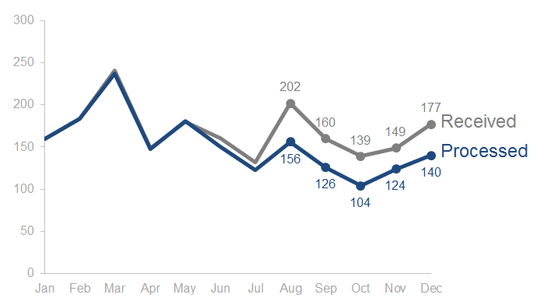
Preattentive Attributes In graphs
Another example (use labels sparingly)

Slide 40
Color
Preattentive Attribute – Color
Use sparingly
Use Consistently
Design with colorblind in mind
Be thoughtful of the tone that color conveys
Use Brand colors

Slide 41
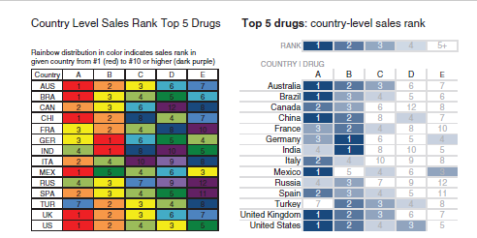
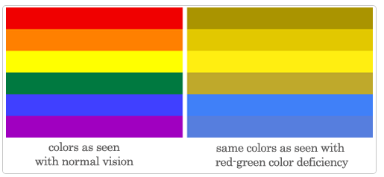
Use color sparingly

Slide 42
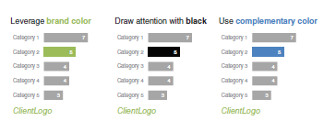
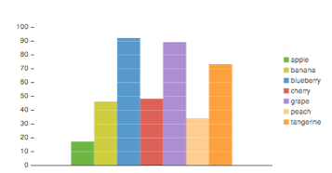
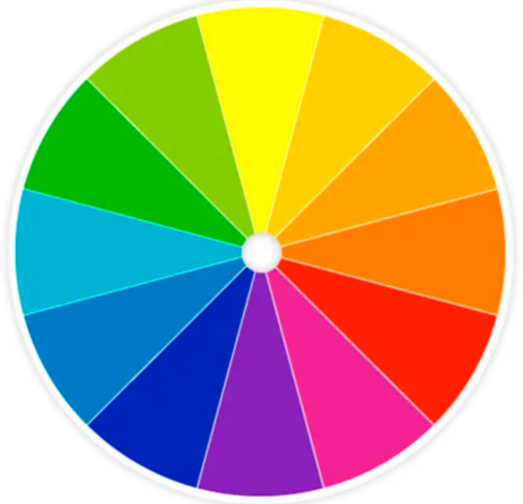
Brand color

Slide 43
Size
Preattentive Attribute – Size
Size matters!
Relative Size --→ Relative Importance!
Similar things -→ Similar Size!

Slide 44
Position
Pre-attentive Attribute – Position
Use top left corner wisely for important stuff
Be mindful of how you position elements on page
Aim to do so in way that will feel natural for audience to consume information

Slide 45
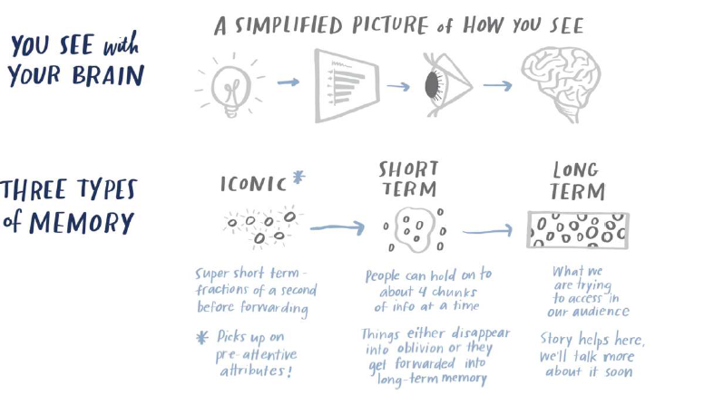
Summary

Slide 46
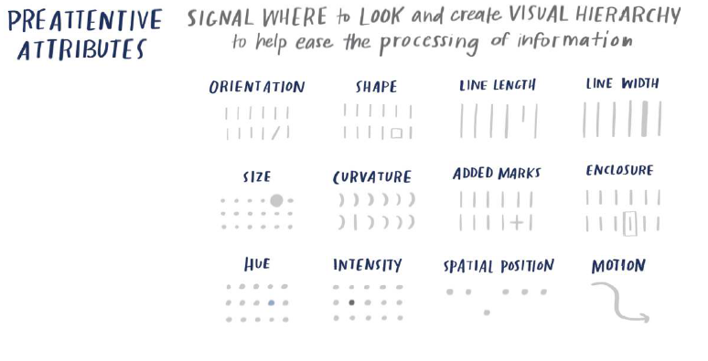
Summary

Slide 47
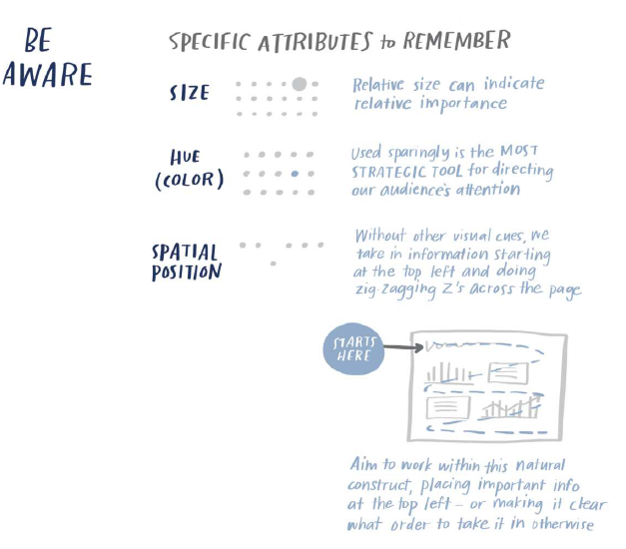
Summary

Slide 48
Thank You!

